Slide 1
Comparative Sentiment Analysis of Mainstream Social Platforms
11810112 JIANG Runzhi
11910117 LI Haobo
Instructor: Dr. James

Slide 2

CONTENT
01、 Retrospect
02、 Defects of the Last Scheme
03、 Exploration and Progress
04、 Future

Slide 3
1
Retrospect

Slide 4

Background
The Chinese Internet has many social platforms, on which netizens can post their comments.
Different social platforms often
carry different functions and have different ways of commenting.

Slide 5
Background
Through crawler, massive comment data can be easily obtained for subsequent analysis.
The research in the field of network user sentiment analysis provides a new method and tool for the prediction of specific social behavior.

Slide 6
Data Collection
For the last time, we used crawlers to get comments from Zhihu, Weibo, and Bilibili.
We chose the comments about topic “俄罗斯”.
For different platforms, different crawlers need to be designed according to their characteristics and anti-crawler Settings.

Slide 7
Data Cleaning
We used jieba to break down the Chinese comments we have collected into words and phrases. These words are used to generate word clouds.
We used regular expressions to remove HTTP tags from the data.
Further more, we added some stop words, to filter some prepositions, including “是”, “其
中”, “里面”, “然后” and so on.

Slide 8
WordCloud
We used the python package WordCloud to generate the word cloud.
By looking at the word cloud, we can see how often different words appear in comments on the platform. The larger the word, the higher the frequency of the comments.
Word clouds help us intuitively analyze the emotional tendencies of comments on various platforms.

Slide 9
Cemotion
Cemotion is a Chinese NLP library in Python, which can analyze Chinese emotional tendencies.
The Cemotion model was trained by the recurrent neural network and returned a confidence level between 0 and 1 for the Chinese text. The larger the value, the more positive the sentence.

Slide 10
2
Defects of the Last Scheme

Slide 11
Few Platforms
Only three platforms included: Zhihu, Weibo, and Bilibili.
The more platforms there are, the more analytical materials they can provide to analyze how they differ from other platforms.

Slide 12
Ugly Word Clouds
The word cloud that was implemented last time was crude and ugly.
Meanwhile, the definition of the word cloud image is very low.
The word cloud needs to be beautified to make it more intuitive and beautiful.

Slide 13
A Single and Fixed Topic
Last time, we fixed the topic of our comments, but different platforms tend to discuss different topics.

Slide 14
Inadequate Emotion Analysis
Only one library, Cemotion, was used to analyze Chinese emotional tendencies.
Its analysis results may not be comprehensive and accurate.

Slide 15
3
Major Progress of the Project

Slide 16
Explore Other Platforms
Douban Crawler
Douban comments are obtained by analyzing HTML tags on web pages.
However, if crawl the web page directly, you cannot get the text you want. That’s because the content is encrypted. By adding parameters(cookies and some keys) to the creeper’s camouflage head, the problem will be solved.

Slide 17
Explore Other Platforms
Douyin Crawler
Because Douyin is an app and there is no web version, and Douyin has done a lot of encryption on its information, so it is very difficult to crawl.

Slide 18

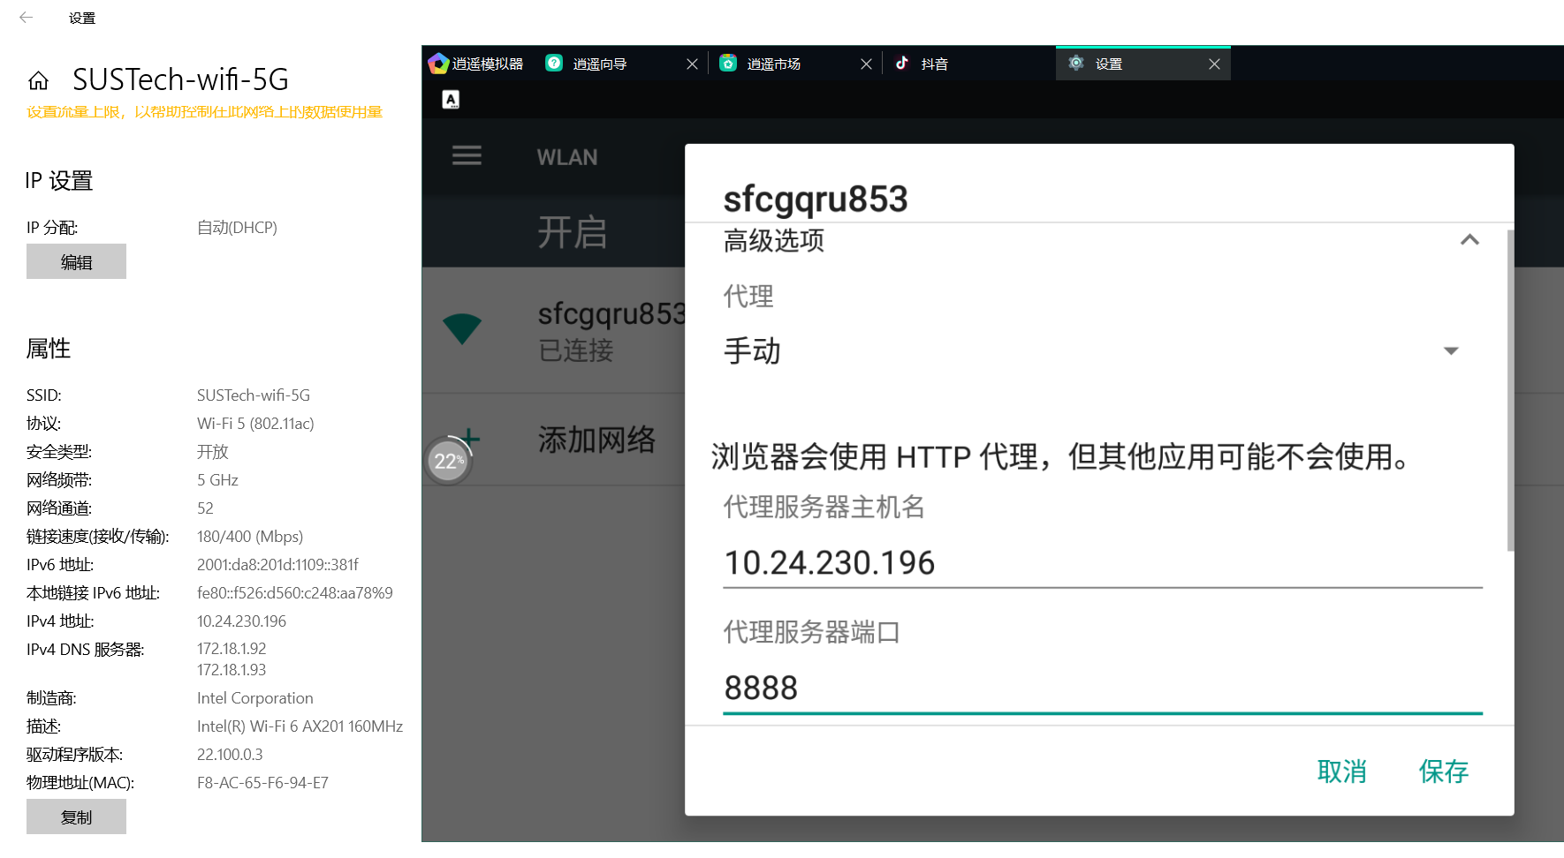
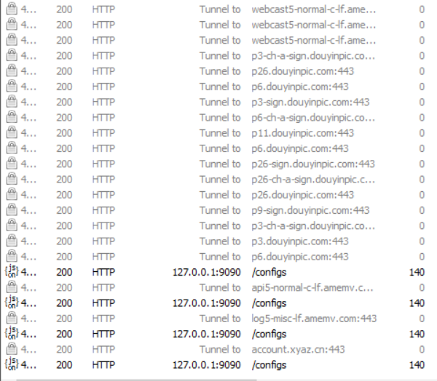
Explore Other Platforms
Douyin Crawler: The First Method Attempt

Slide 19

Explore Other Platforms
Douyin Crawler: The Second Method Attempt
Try copying the video link on phone and opening it on computer, because open in the computer side can check its HTML structure, and extract the comment information we need.
However, Douyin has a lot of anti-crawler settings, and opening Douyin links on the PC often
requires authentication.

Slide 20
Explore Other Platforms
Douyin Crawler: The Second Method Attempt
Furthermore, after layer upon layer of encryption, the JSON file containing comment information cannot be found.
Therefore, it is impossible to crawl Douyin comments through
Links.

Slide 21
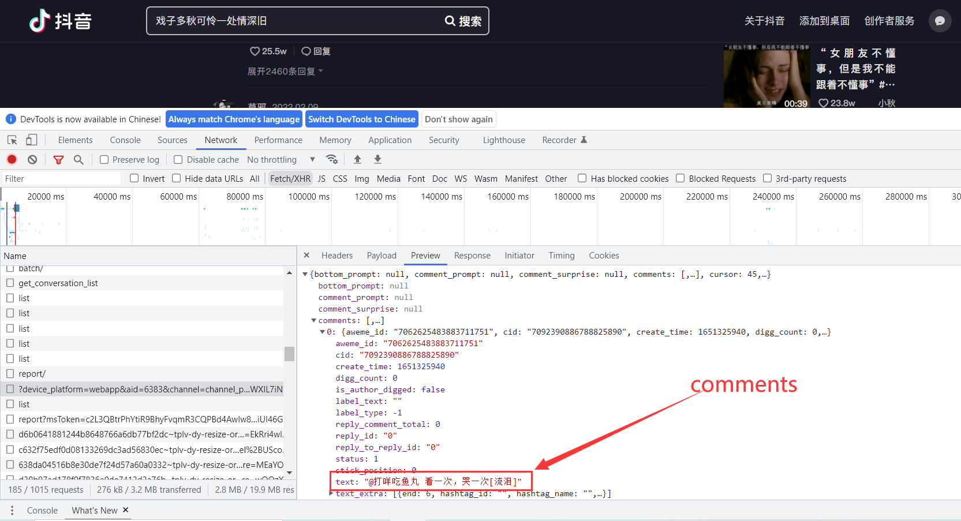
Explore Other Platforms
Douyin Crawler
Because Douyin is an app and there is no web version, and Douyin has done a lot of encryption on its information, so it is very difficult to crawl.

Slide 22
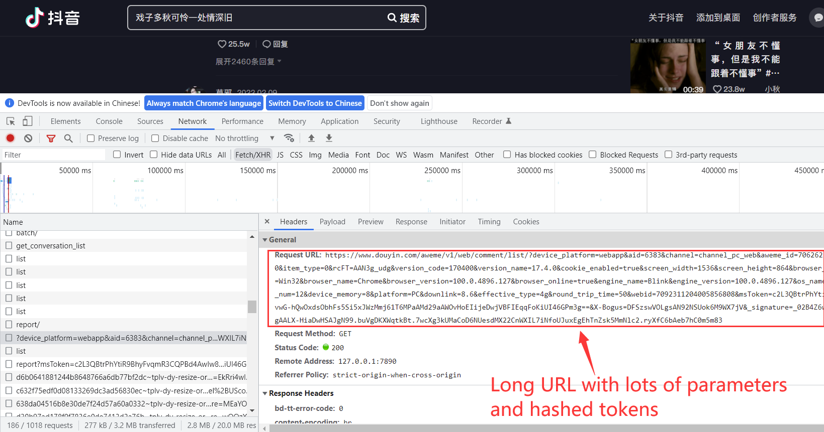
Explore Other Platforms
Douyin Crawler
Because Douyin is an app and there is no web version, and Douyin has done a lot of encryption on its information, so it is very difficult to crawl.

Slide 23
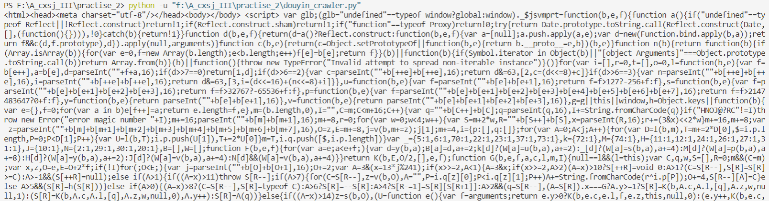
Explore Other Platforms
Douyin Crawler: The Third Method Attempt
Also, parsing the HTML directly to get the tag containing the comment is also not desirable because Douyin encrypts its content.
In this way, crawling directly into its HTML
does not yield its comment data.

Slide 24
Data Collection
We crawled comments of top topics of each platform.
Comments on trending topics can better reflect the emotional leanings of users on the platform.
The data collected including :
Bilibili top 10 hot video comments
Top 10 hot topics’ top answers on Zhihu
Top 15 most searched topics’ comments on Weibo
Comments on top 10 topics on Douban.

Slide 25
Data Cleaning
We used regular expressions to remove HTTP tags from the data.
Also, we used stop words to filter some prepositions.

Slide 26
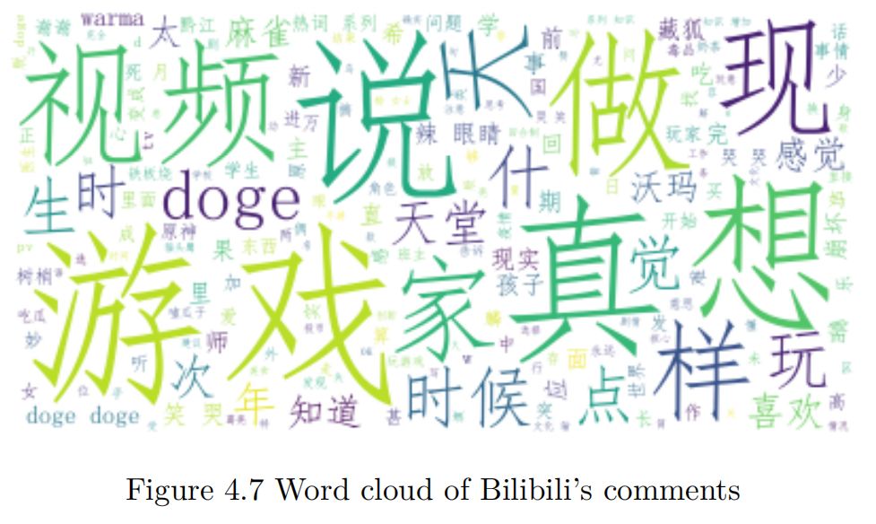
Data Cleaning
We used regular expressions to remove HTTP tags from the data.
Also, we used stop words to filter some prepositions.

Slide 27
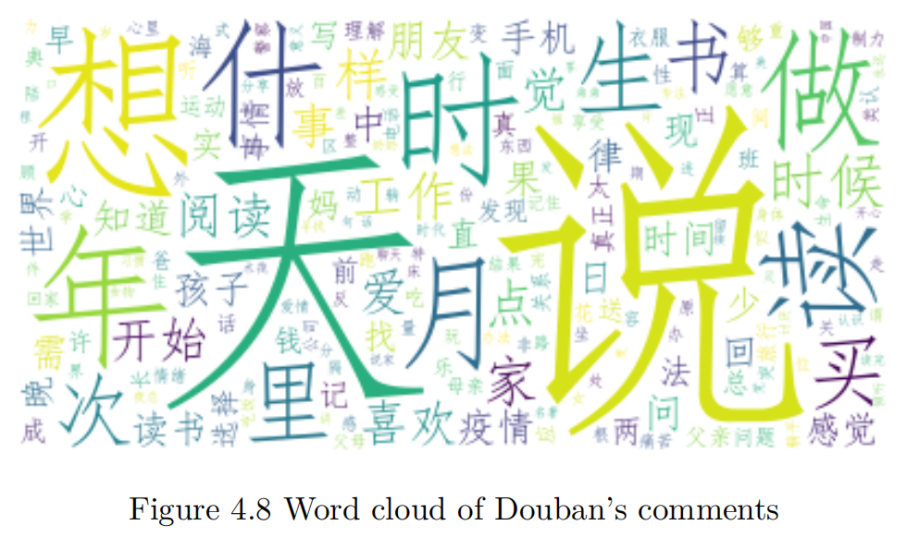
Data Cleaning
We used regular expressions to remove HTTP tags from the data.
Also, we used stop words to filter some prepositions.

Slide 28
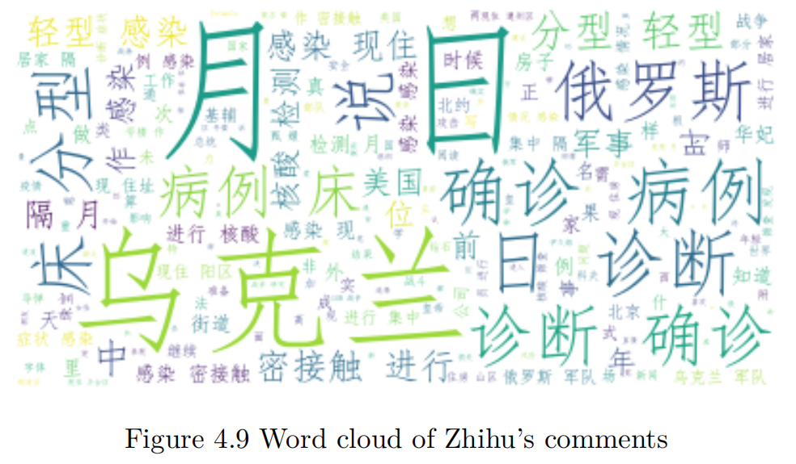
Data Cleaning
We used regular expressions to remove HTTP tags from the data.
Also, we used stop words to filter some prepositions.

Slide 29
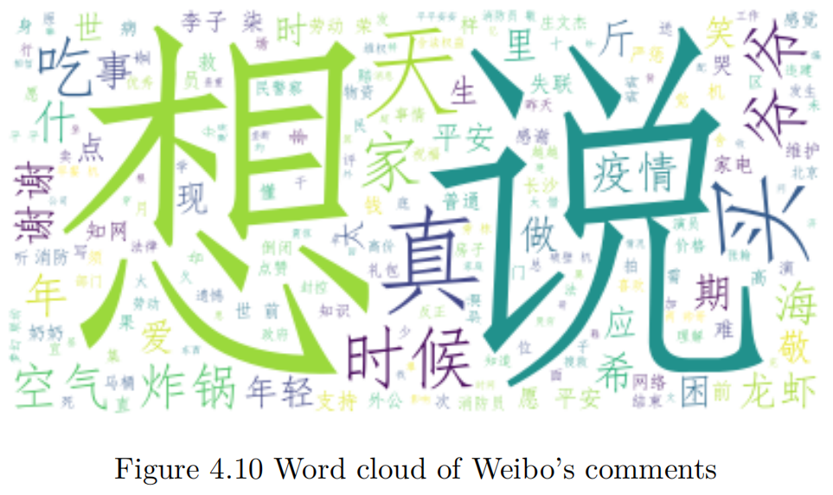
Data Cleaning
We used regular expressions to remove HTTP tags from the data.
Also, we used stop words to filter some prepositions.

Slide 30
Data Cleaning and Words Clouds Improvement
Therefore, we add these common nouns and verbs to stop words then.
However, individual words tend to appear more frequently and have little practical meaning.
It is better to remove all individual words.
The definition of the word cloud before is very low
Set different fonts for the word cloud.

Slide 31
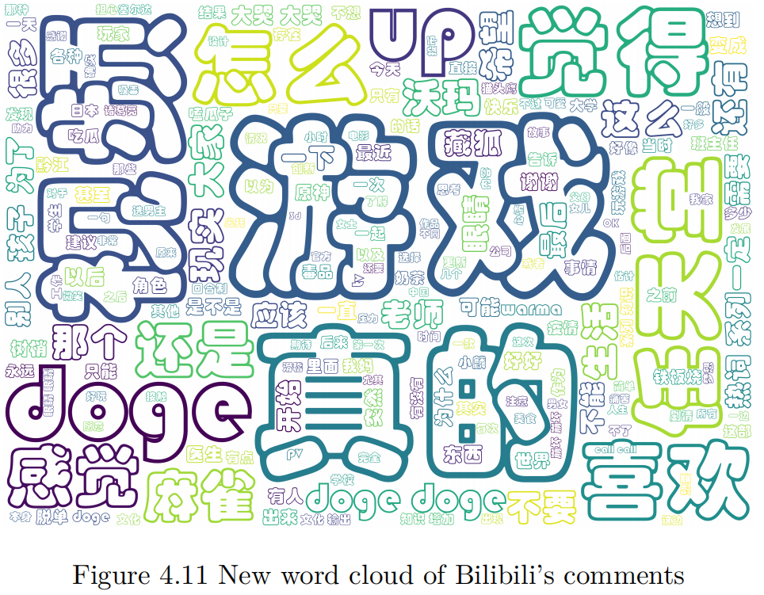
New Words Clouds

Slide 32
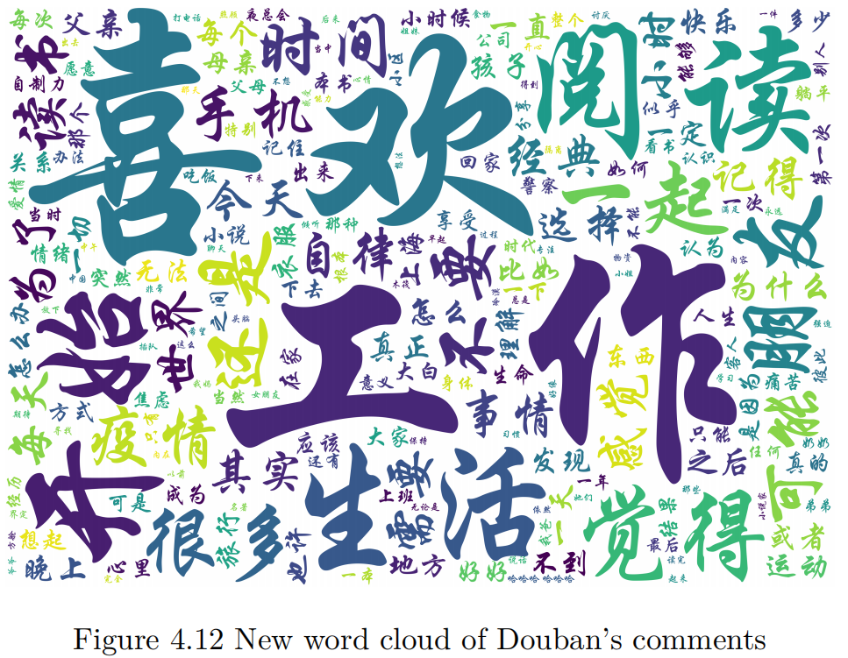
New Words Clouds

Slide 33
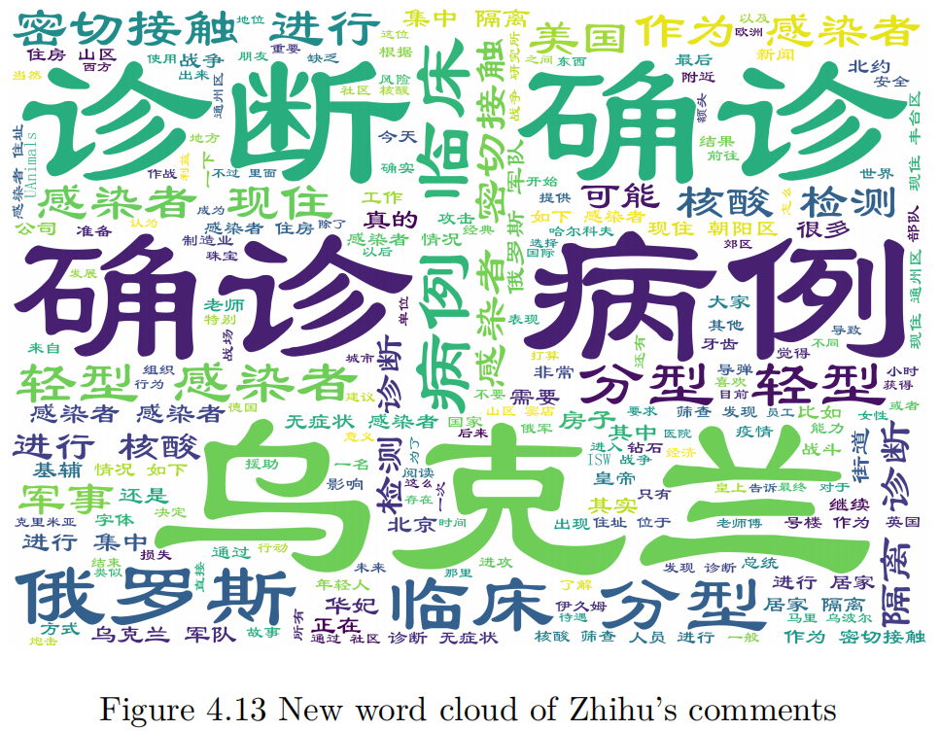
New Words Clouds

Slide 34
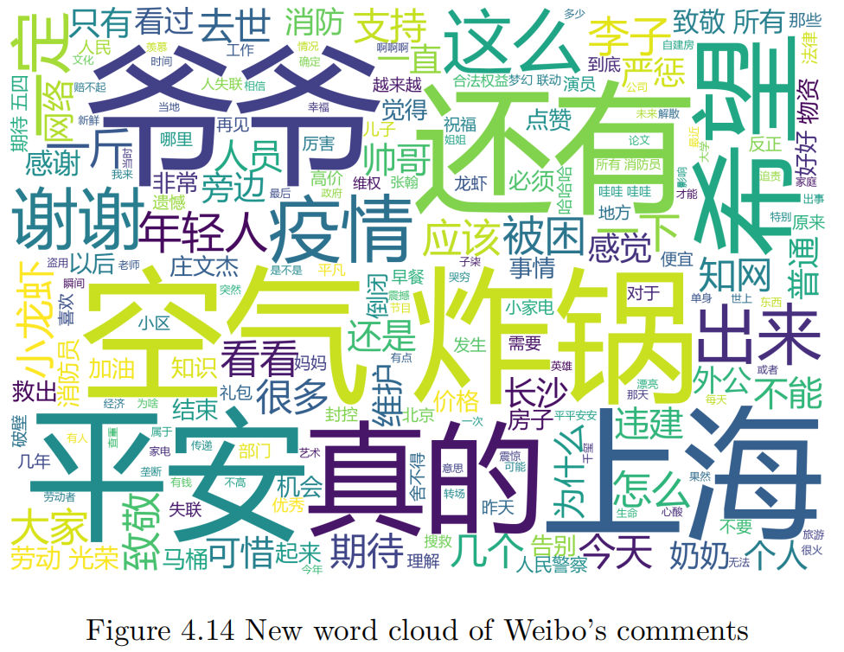
New Words Clouds

Slide 35
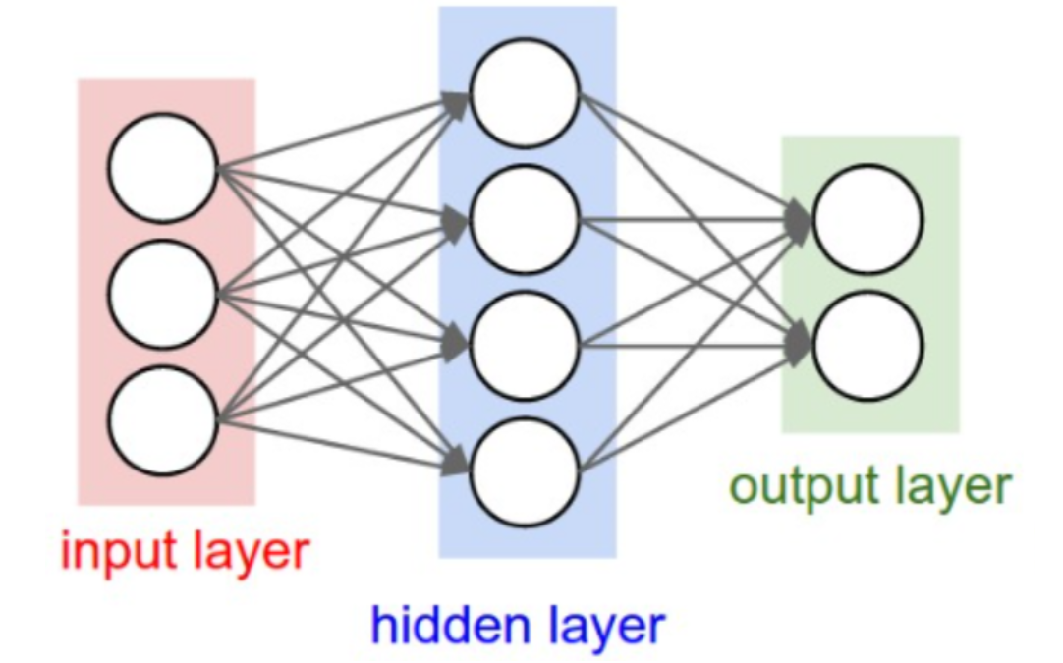
Understand principle
-Why not ANN

Slide 36
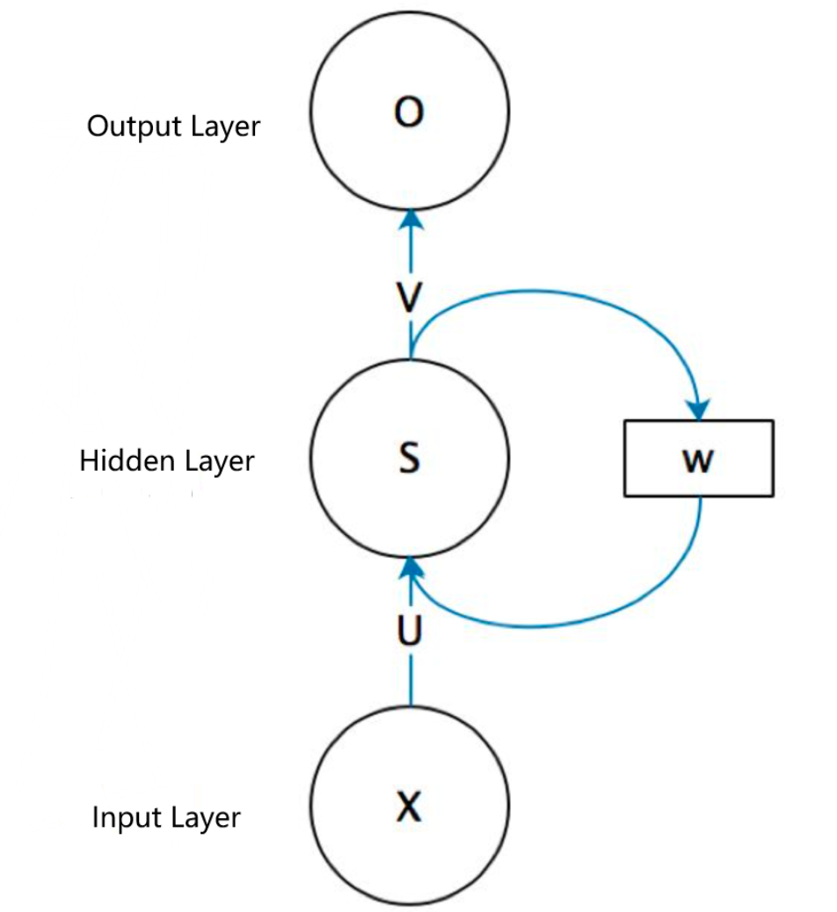
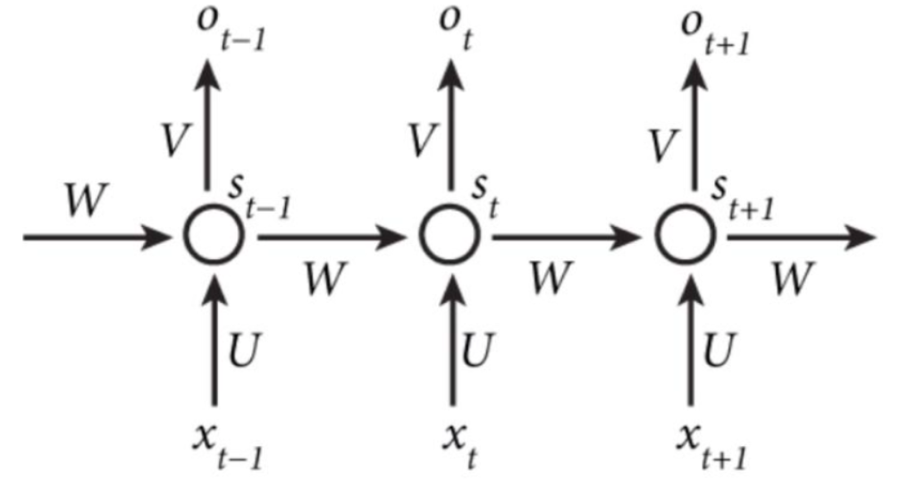
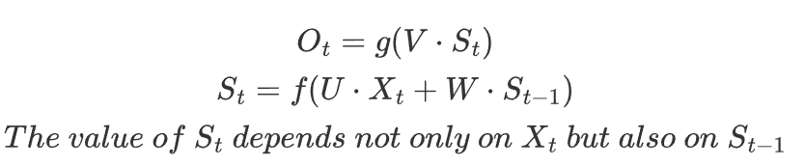
What is RNN and why?

Slide 37
Input processing
Str = “一棵是枣树另一棵也是枣树”
After participle：
[一棵，是，枣树，另，一棵，也，是，枣树]
After mapping:
[一棵，是，枣树，另，一棵，也，是，枣树] = [1, 2, 3, 4, 1, 5, 2, 3]
After standardized:
[0, 0, 1, 2, 3, 4, 1, 5, 2, 3] = [Null, Null, 一棵，是，枣树，另，一棵，也，是，枣树]

Slide 38
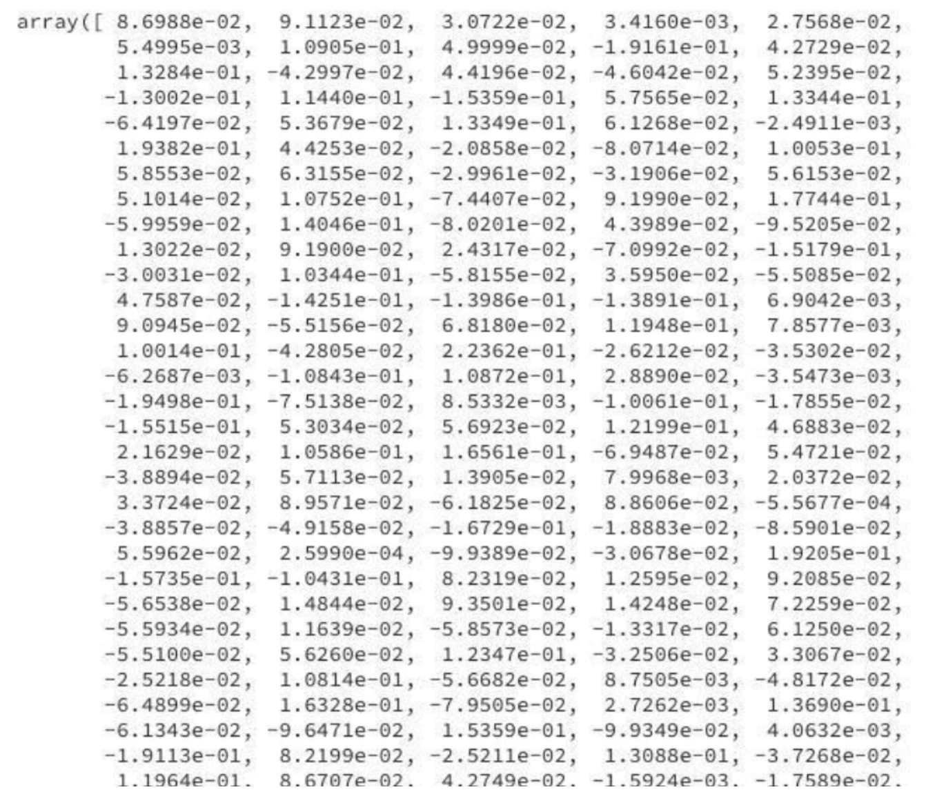
Word embedding(projection):
的

Slide 39
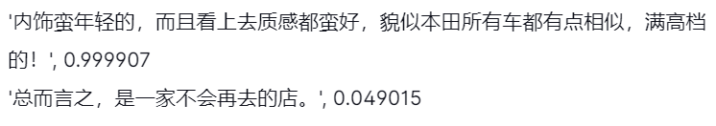
Sentiment analysis --Review
Cemotion is a Chinese NLP library in Python, which can analyze Chinese emotional tendencies.
The Cemotion model was trained by the recurrent neural network and returned a confidence level between 0 and 1 for the Chinese text.
The larger the value, the more positive the sentence.

Slide 40
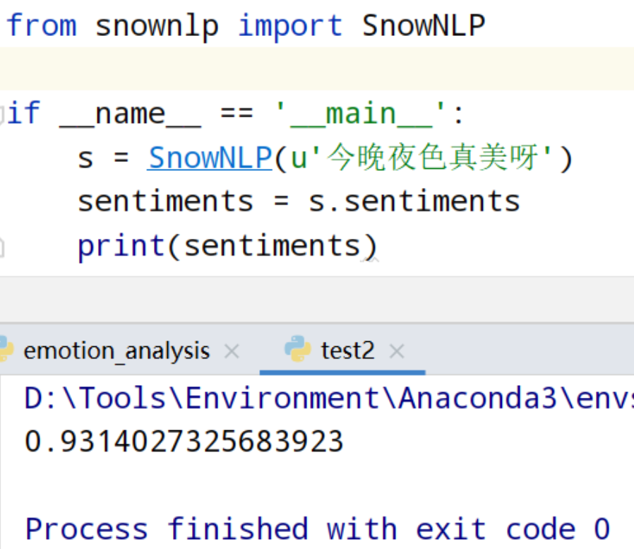
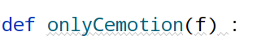

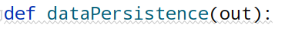
Import SnowNLP

Slide 41
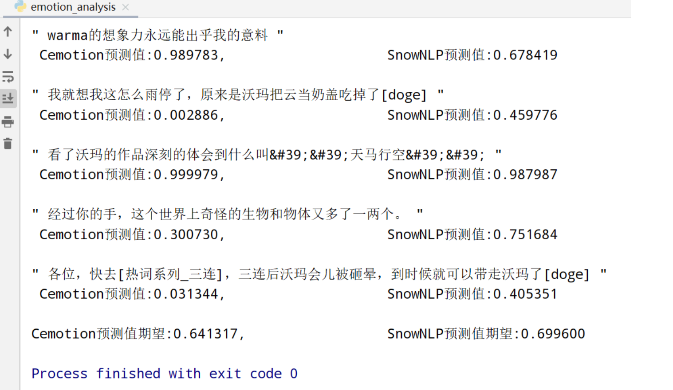

Slide 42
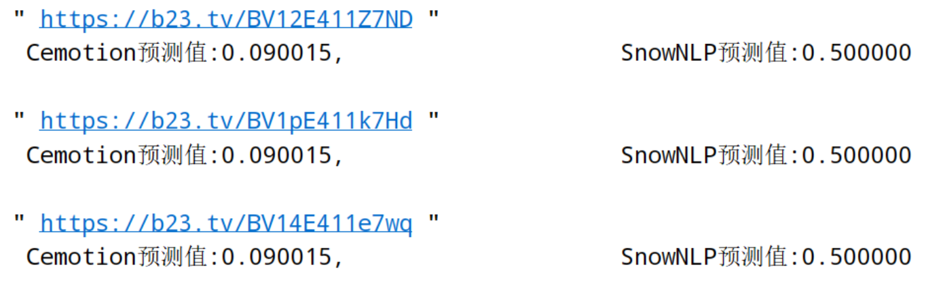
Verify accuracy
First: some special case

Slide 43
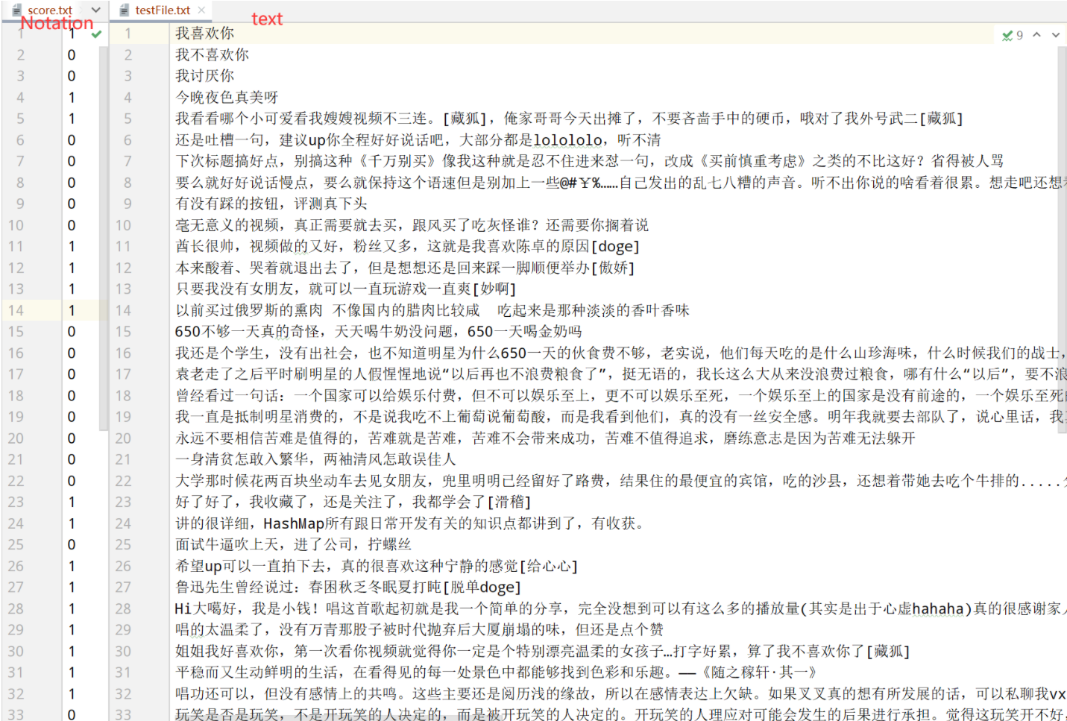
Second: Error check

Slide 44
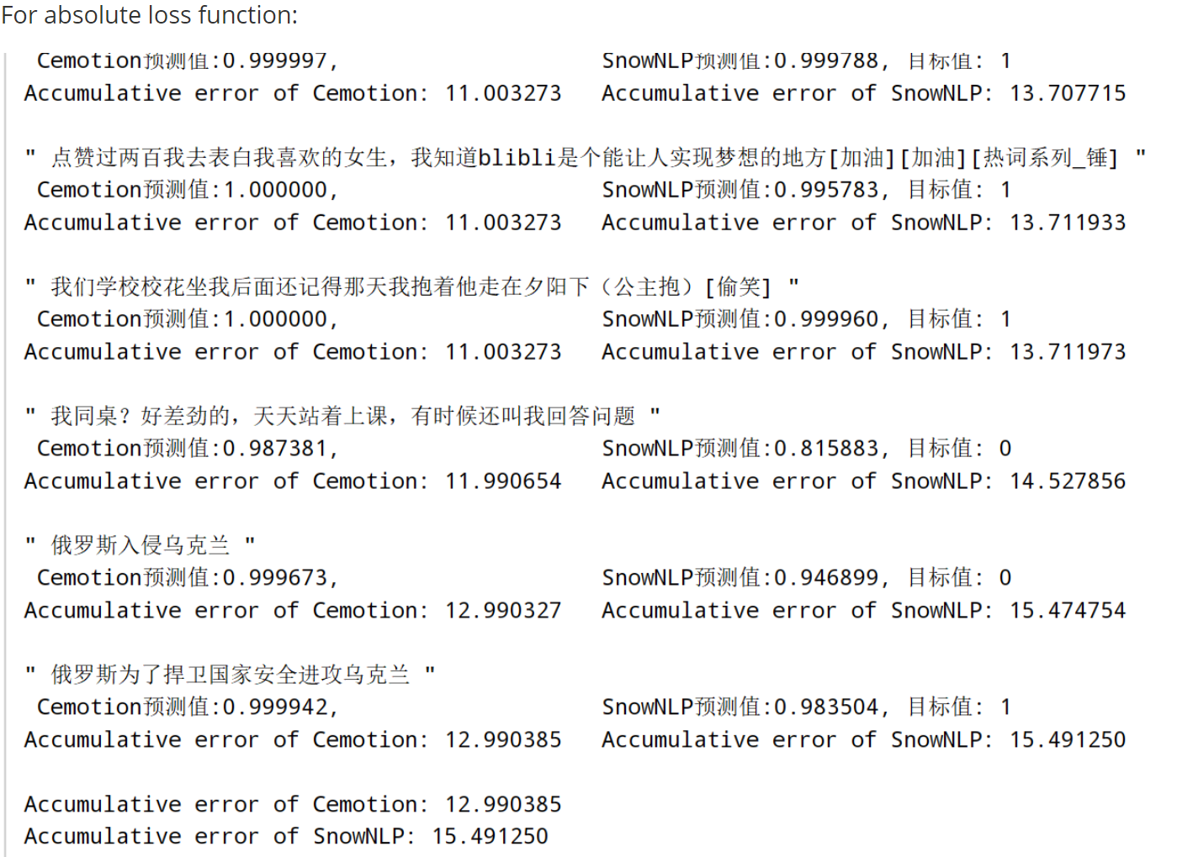

Slide 45
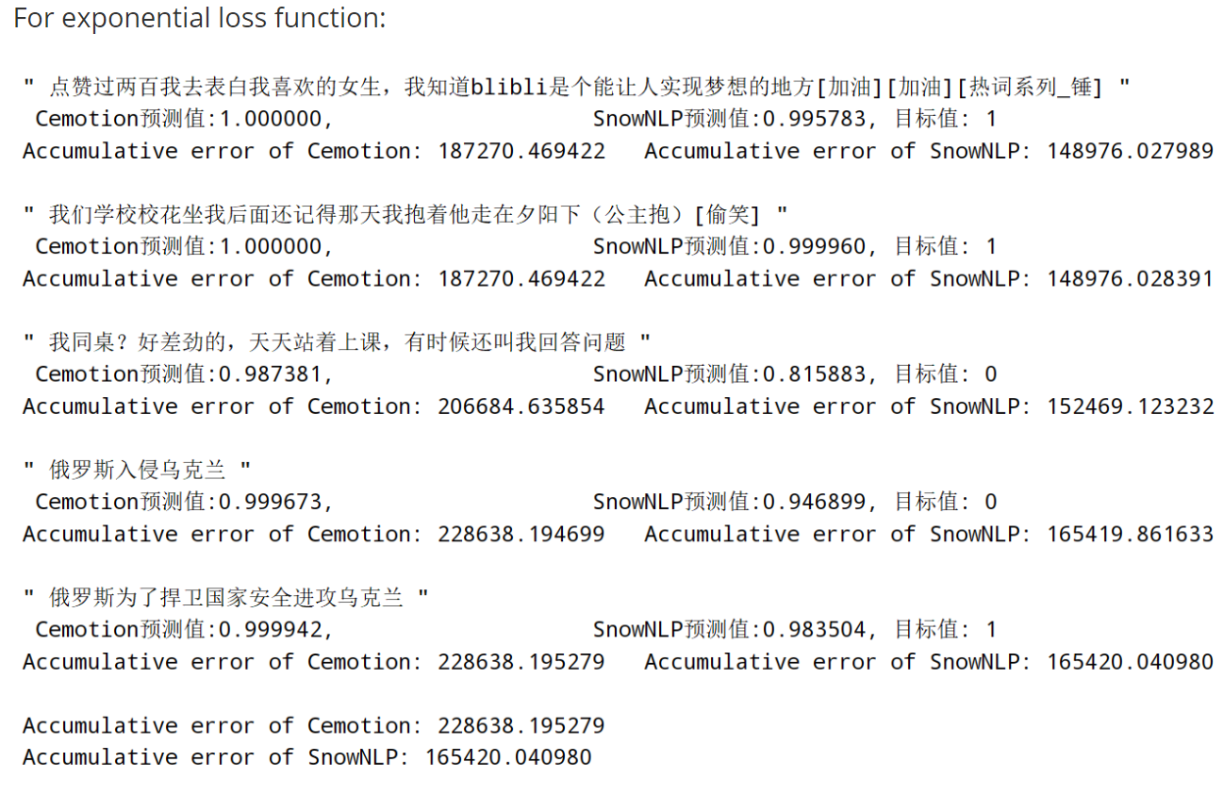

Slide 46
Verify accuracy
Conclusions:
Cemotion tends to give extreme predictions, such as 1,0.9999, and 0.0005, which are prone to large differences between the prediction and the target (&gt; 0.5).
SnowNLP is more conservative, with fewer and more credible instances of that happening.

Slide 47
The Prospect of Future
Crawl More Platforms
Further explore the principle
Systematic

Slide 48
Thank You

